Slide 1
Bank deposits
Author: George Zhechev 9b

Slide 2
Purpose and main functions
The purpose of our project is to develop a program for managing our bank deposits.
Main functions:
Enter depositor
Enter deposit
Withdraw deposit
Withdrawing the last deposit, deletes the depositor.
List of all depositors and deposits

Slide 3
Restrictions
The deposits are in three currencies: BGN, USD and EUR.
Each depositor can have one deposit in each currency.
Each depositor has a unique number generated by the system.
You can’t change the number assigned by the system.

Slide 4
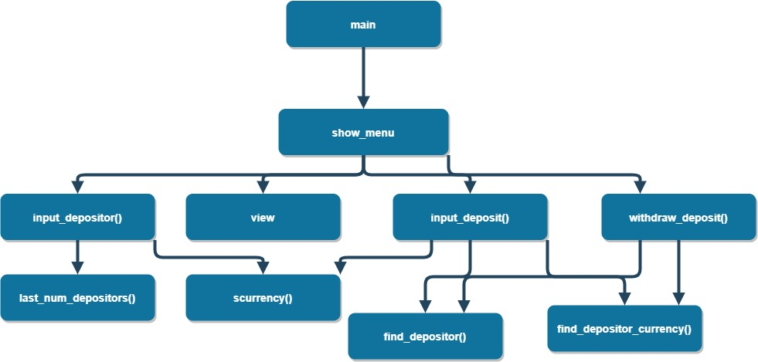
Diagram of functions calling

Slide 5
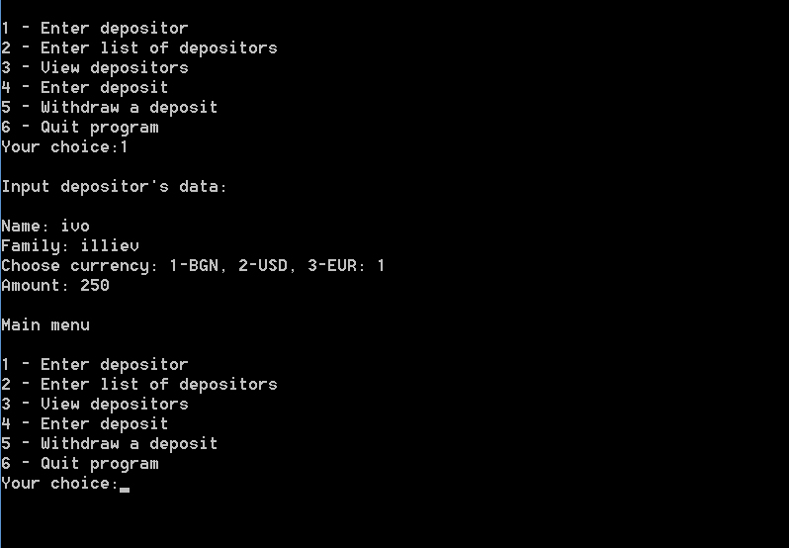
Program screen

Slide 6
Program data
struct Deposit{
int number;
string name, family, currency;
float amount;
};

Slide 7


